Slide 1
Capstone Project - 2
Bike Sharing Demand Prediction ML Supervised Regression pradyumna vikram singh

Slide 2
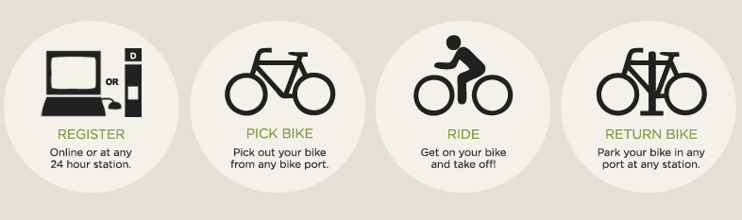
Concept of Bike Sharing
The basis concept of bike sharing is sustainable transportation. Bike sharing programs have expanded rapidly in recent years as cities search for ways to increase bike usage, increase mobility choices and reduce adverse environmental impacts.
It is a convenient, environmentally friendly way to get around town, but has flaws too. There are certain conditions that must be met for proper implementation of this program. Bike sharing Demand is affected by multiple factors including temperature, resources and many more.

Slide 3
Let’s predict Bike Sharing Demand in Seoul
1. Defining problem statement
2. Data Summary
2. EDA and feature Engineering
3. Feature selection
4. Preparing Dataset for modelling
5. Implementing Regression models
7. Model Validation & Selection
6. Challenges
7. Conclusions
8. Q&A

Slide 4
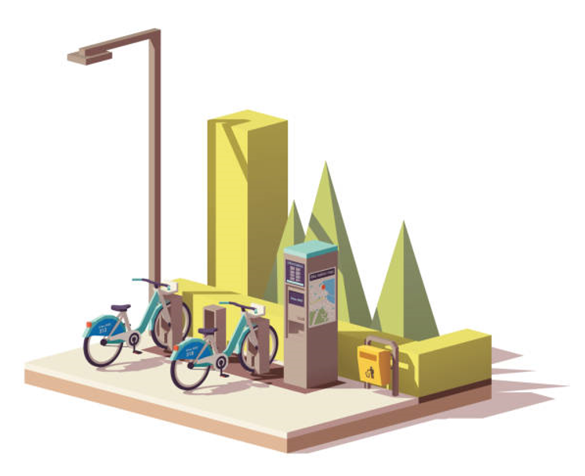
Problem statements
Prediction of bike count required at each hour.
What factors affect bike sharing count ?
Reduce waiting time of public.
Need of machine learning to predict bike demand:
The idea of this project is to create a predictive model that identifies upcoming trends in bike sharing demand.
It is crucial to keep in mind that machine learning can only be used to memorize patterns that are present in the training data, so we can only recognize what we have seen before. When using Machine Learning we are making the assumption that the future will behave like the past, and this isn’t always true.

Slide 5
Data pipeline
Preparing the data_1 : In this first part, we’ve done data inspection where we checked null or missing values and did multiple operations to make sure our dataset is up to the mark.
Preparing the data_2 : Checked all the features, extracted data feature to get more data. Now as dataset is ready, we moved to the next step.
EDA : In this part, in order to see the trends we did some exploratory data analysis on the features and checked distribution of data points and correlation with dependent variable.

Slide 6

Create model : After Data preparation, We feed our machine learning model with numerical data. This process is called model building. We start with simple algorithm but model complexity increases for better performance.
Choose a Measure of Success : After applying every model, we measure it’s accuracy by some evaluation matrices.

Slide 7
Data summary
Date - year-month-day
Rented Bike count - Count of bikes rented at each hour
Hour - Hour of he day
Temperature-Temperature in Celsius
Humidity - %
Windspeed - m/s
Visibility - 10m
Dew point temperature - Celsius
Solar radiation - MJ/m2
Rainfall - mm
Snowfall – cm
Seasons - Winter, Spring, Summer, Autumn
Holiday - Holiday/No holiday
Functional Day - NoFunc(Non Functional Hours), Fun(Functional hours)

Slide 8
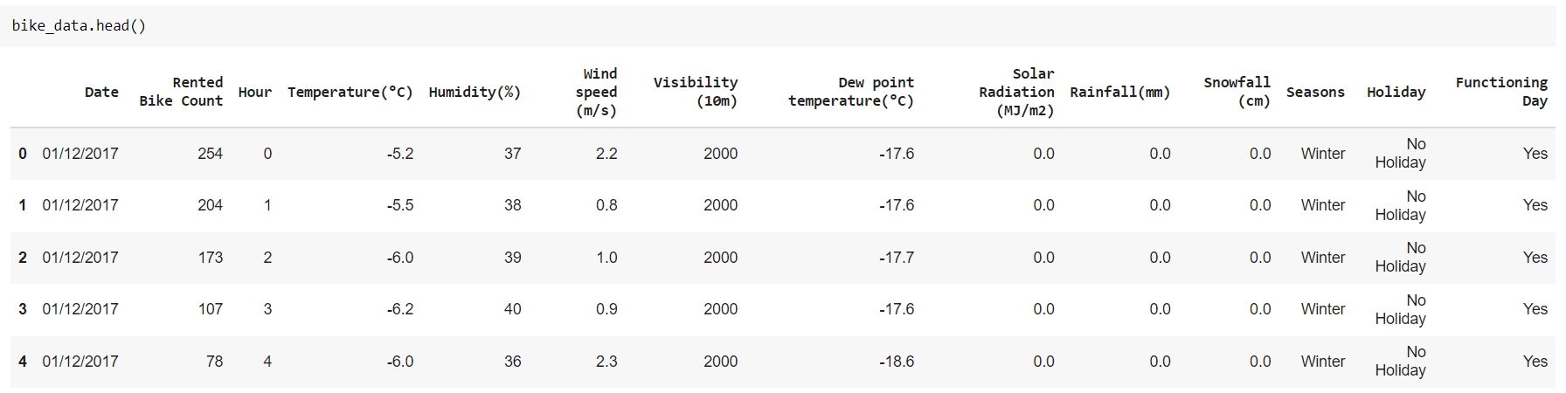
Basic Data Exploration
This Dataset has 8760 columns and 14 Rows.
There are 3 categorical features ‘Seasons’, ‘Holiday’, & ‘functioning Day’.
One datetime feature ’Date’.
Dataset contains no null values
No missing or duplicates values.

Slide 9
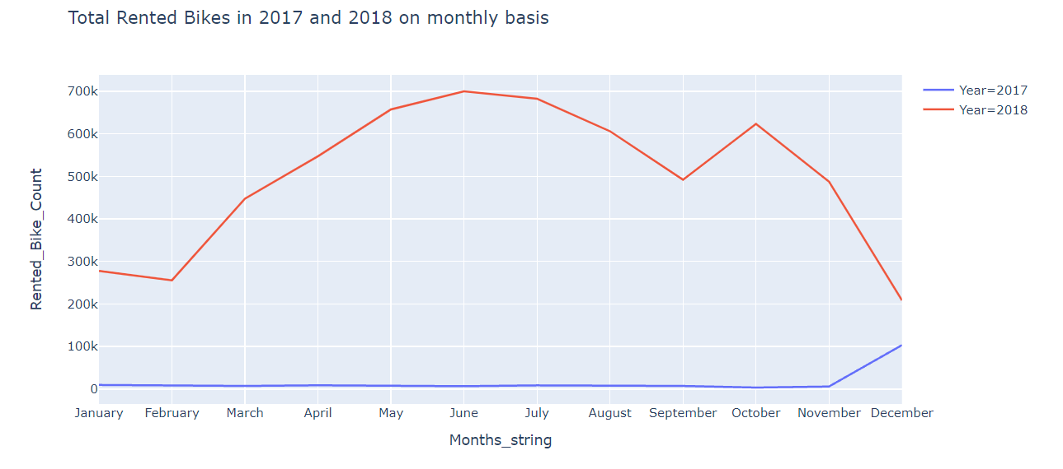
EDA
Rented bike count on Different months in 2017 and 2018
Rented bike count was very low in 2017.
In 2018, There is a sharp increase in Rented bike count.

Slide 10
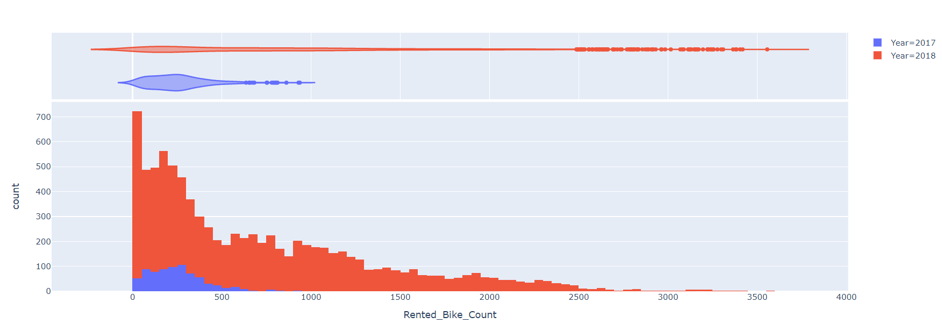
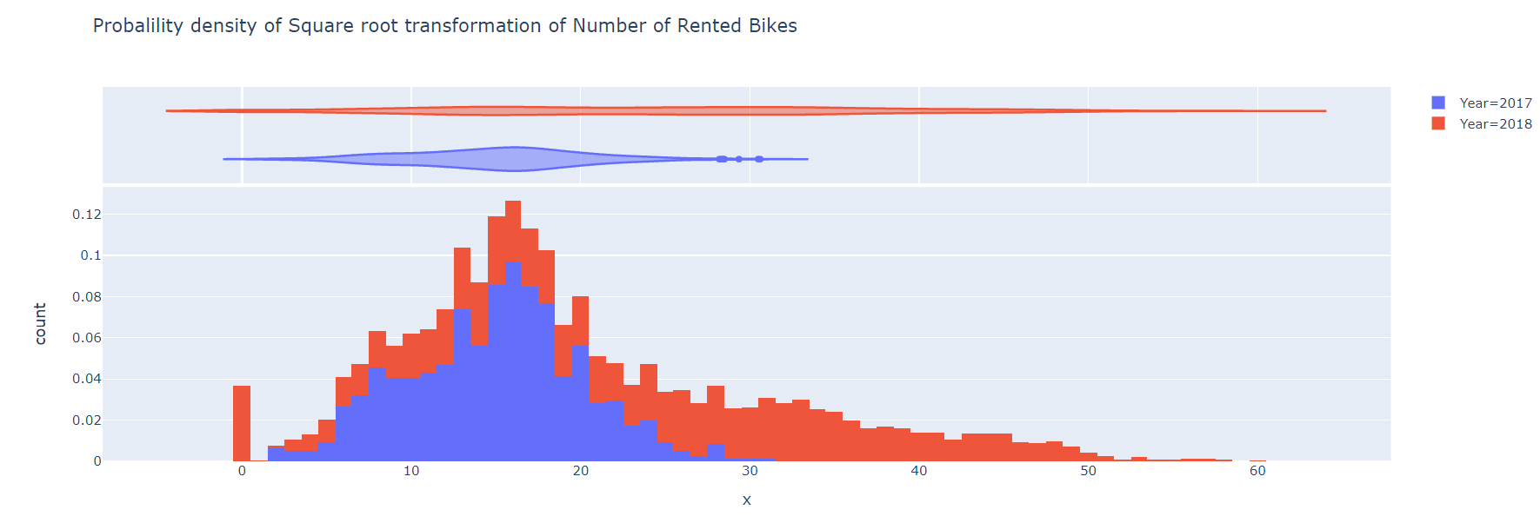
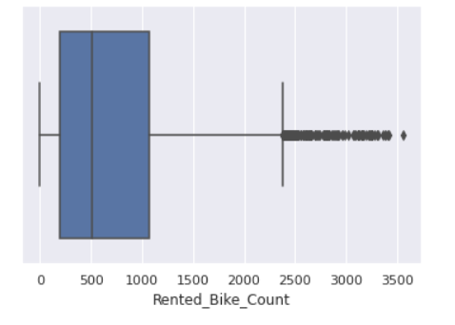
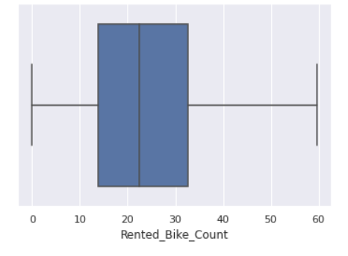
EDA - Checking distribution of our dependent variable

Slide 11
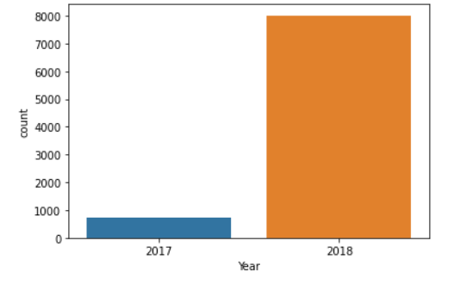
EDA - Bike count in 2017 and 2018
Our dataset mostly contains information of year 2018 and very little information of year 2017.

Slide 12
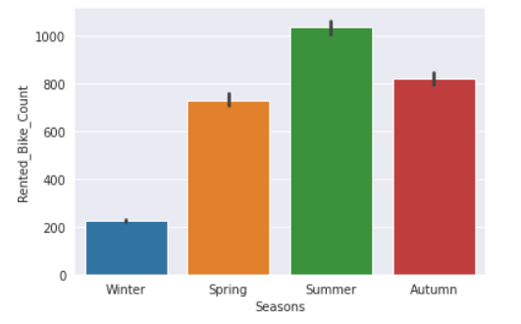
EDA - Distribution of rented bike according to different seasons
Rented bike count is less in winter and almost consistently higher in other months.

Slide 13
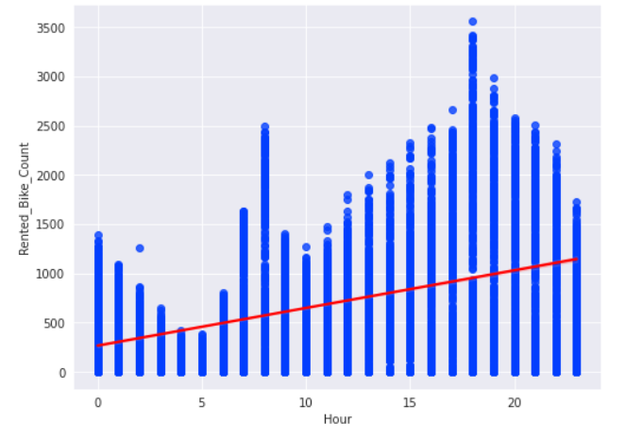
EDA - Rented bike count per hour
Hour is a numerical feature.
Hour: Demand for bike is mostly in morning (7 to 8) and in the evening (3 to 9).

Slide 14
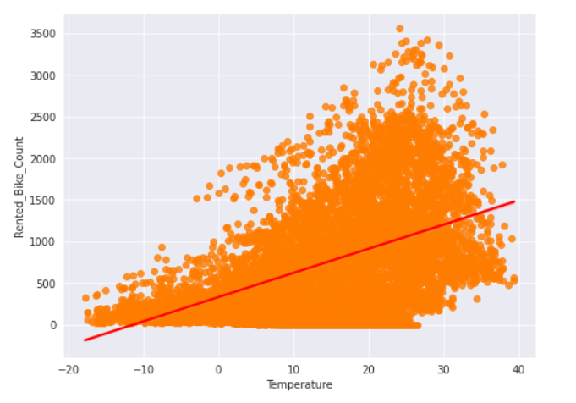
EDA - Relationship between bike count and Temperature
Temperature : Temperature is positively correlated. Rented bike count is highest between 20 °C and 30 °C. So, it means temperature has an effect.

Slide 15
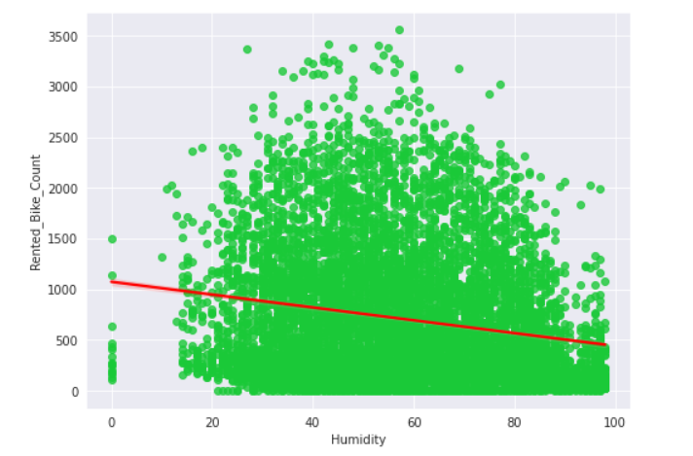
EDA - Relationship between bike count and Humidity
Humidity : Humidity is the amount of water vapor in the air. So, People preferring to borrow bike When there is less humidity.

Slide 16
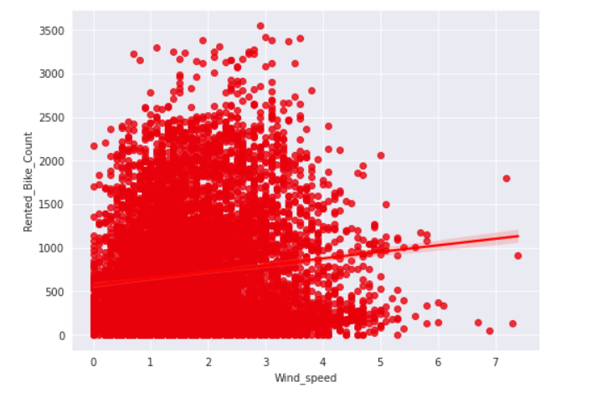
EDA - Relationship between bike count and Windspeed
Windspeed : Consumers prefer bikes when windspeed is in particular range but looking at plot, we can conclude that wind speed doesn't affect our data much.

Slide 17
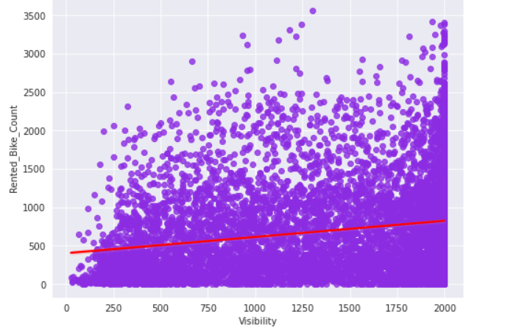
EDA - Relationship between bike count and Visibility
Visibility: Visibility doesn't affect our results much but all we know is that it is positively correlated with bike count.

Slide 18
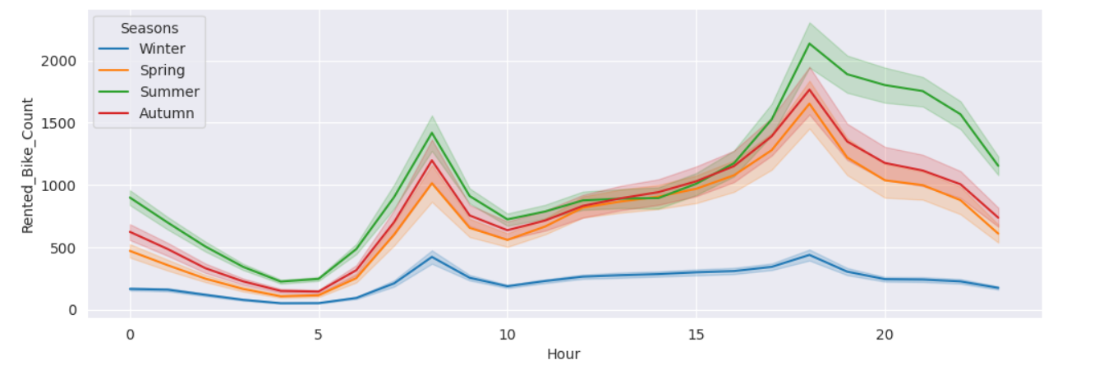
EDA - Rented bike count in different seasons
There is an Amazing insight that consumers prefer borrowing bikes more in a particular season. Rented bike count is highest in summer and least in winter.

Slide 19
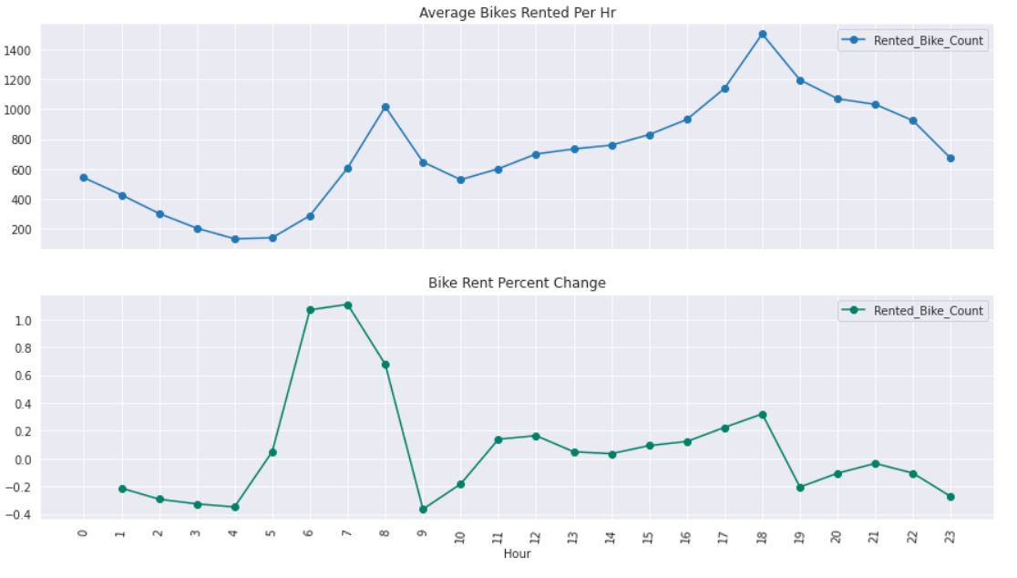
Plot of average rent over time(hrs) with precent change for rent over time(hrs)

Slide 20
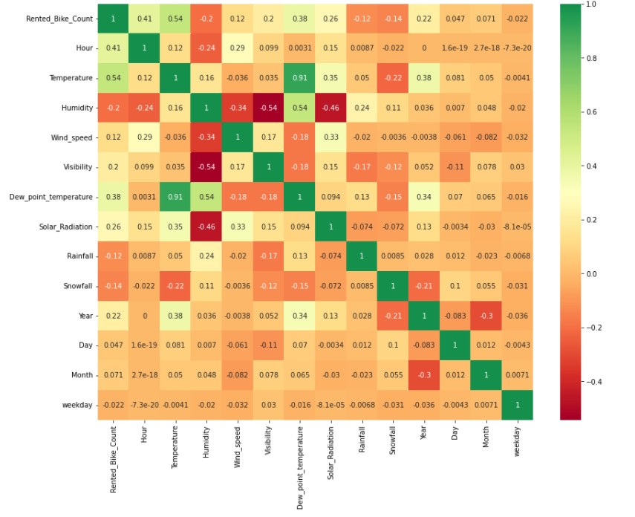
Correlation between Different factors by using Heatmap
Multicollinearity : Dew point temperature and Temperature are variables which are highly correlated.

Slide 21
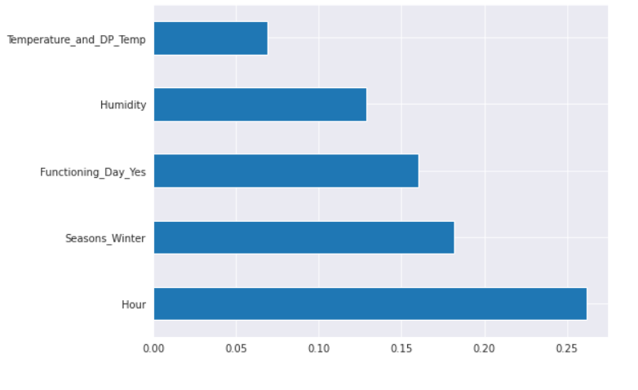
Plot graph of feature importance
These 5 features affect our dependent variable most.
Hour feature has highest importance so far.

Slide 22
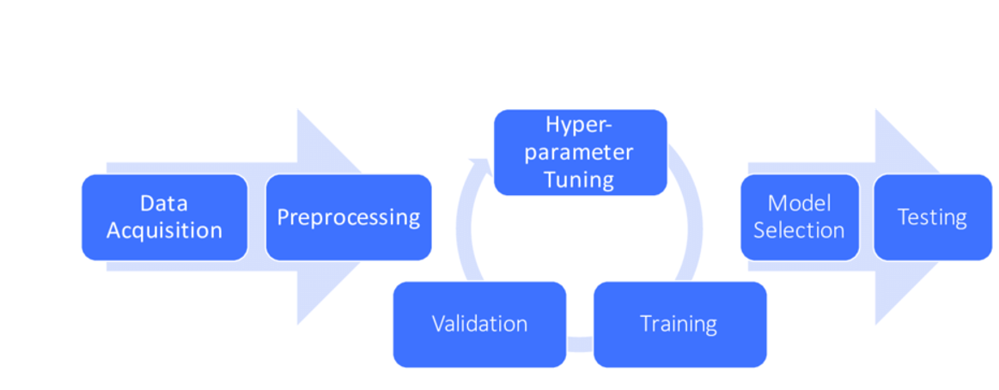
Preparing Dataset for Modelling
Dataset:
Train set: (7008, 16)
Test set: (1752, 16)
Handled ‘Dew point Temperature’ and ‘Temperature’ as they were highly correlated.
Dropped ‘Date’ column after extracting useful features from it.
Carefully handled feature selection part as it affects R2 score.

Slide 23
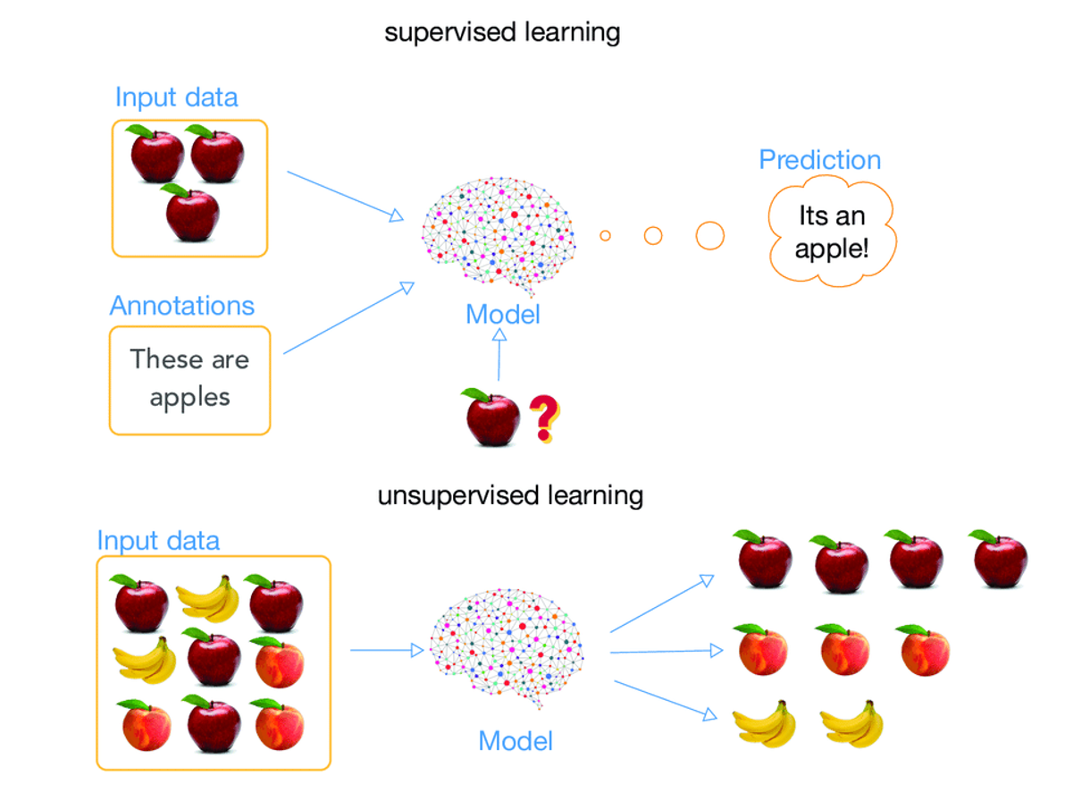
Modeling Overview
Type – Supervised Learning
In this project, we are using four model on our data set for getting best performance :
LINEAR REGRESION
LASSO REGRESSION
RIDGE REGRESSION
GRADIENT BOOSTING
DECISION TREE
RANDOM FORREST
XGBOOST

Slide 24
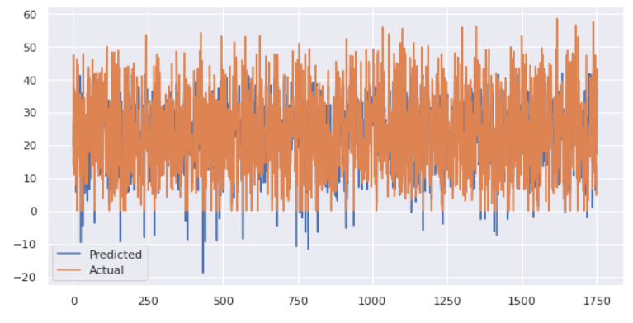

Implementing linear regression (Baseline Model)
Accuracy is just 65%, we need to look for more algorithms.

Slide 25
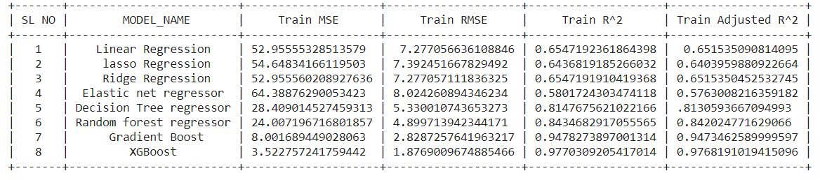
Model Validation & Selection
Model Summery for the train data set (Hyperparameter tuned)

Slide 26
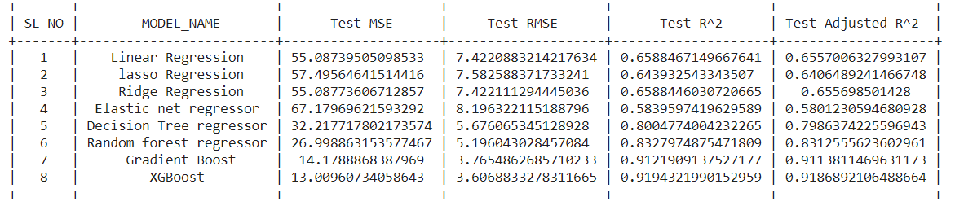
Model Validation & Selection
Model Summery for the test data set (Hyperparameter tuned)

Slide 27
Model Validation & Selection
Observation 1:From model summary table, Linear regression is not giving us accurate result.
Observation 2: lasso, ridge and elastic net regressor didn’t give any good results either. So, we went for more M.L. models.
Observation 3: Decision tree and Random forest gave decent results with approx. 80% accuracy.
Observation 4: Gradient Boost and XGBoost gave us better results. We came to the conclusion that XGBoost is performing better than all other algorithms with accurate.

Slide 28

Scenario while applying Gradient Boost
On using GridSearchCV for the Gradient boost regressor, we get best hyperparameters. They are given below.
Best hyperparameters:
base_score=0.5, booster='gbtree', colsample_bylevel=1, colsample_bynode=1, colsample_bytree=1, gamma=0, importance_type='gain', learning_rate=0.1, max_delta_step=0, max_depth=8, min_child_weight=1, min_samples_leaf=40, min_samples_split=50, missing=None, n_estimators=100, n_jobs=1, nthread=None, objective='reg:linear', random_state=0, reg_alpha=0, reg_lambda=1, scale_pos_weight=1, seed=None, silent=None, subsample=1, verbosity=1)

Slide 29

Scenario while applying XGBoost
On training Xgboost regressor with Gridsearch, best hyperparameters obtained are given below.
Best paramteters:
base_score=0.5, booster='gbtree', colsample_bylevel=1, colsample_bynode=1, colsample_bytree=1, gamma=0, importance_type='gain', learning_rate=0.1, max_delta_step=0, max_depth=8, min_child_weight=1, min_samples_leaf=40, min_samples_split=50, missing=None, n_estimators=100, n_jobs=1, nthread=None, objective='reg:linear', random_state=0, reg_alpha=0, reg_lambda=1, scale_pos_weight=1, seed=None, silent=None, subsample=1, verbosity=1

Slide 30
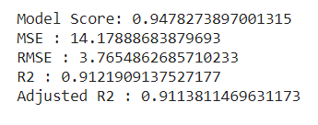
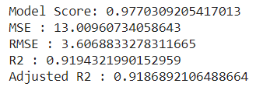
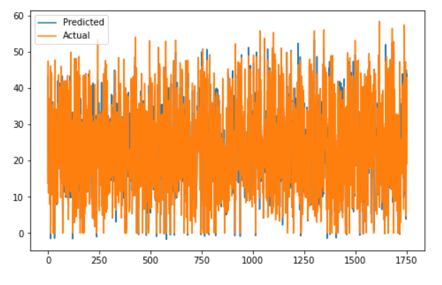
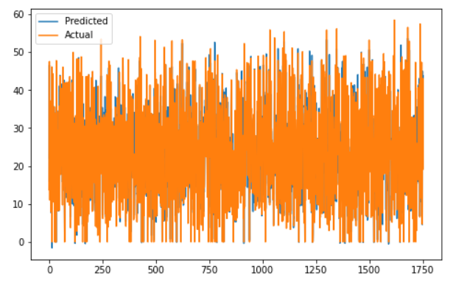
Gradient Boost
XG boost
We can now conclude that XGBOOST has higher accuracy.
X`

Slide 31
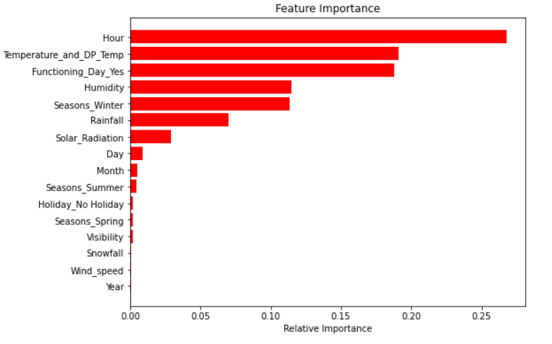
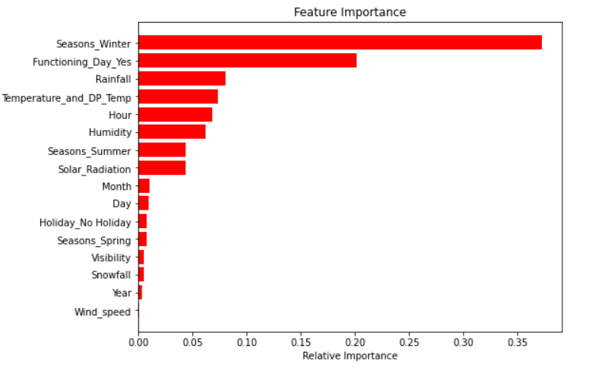
Feature Importance
Gradient boost
XGBOOST

Slide 32
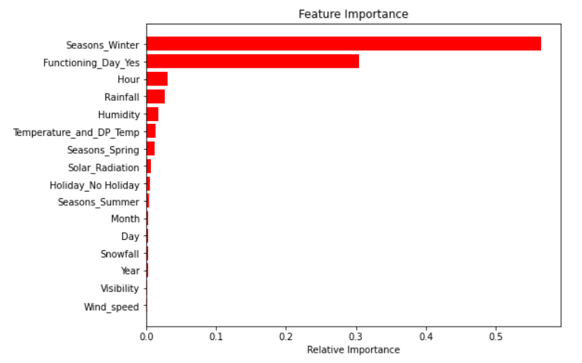
Feature importance with xg train
Winter season is the most relevant feature here.

Slide 33

Challenges
Large dataset to handle
Feature engineering
Feature selection - Making sure we don’t miss any important feature.
Careful tuning of hyperparameters as it affects R2 score.
Computation time

Slide 34
Conclusion
We implemented 8 M.L. models. After comparing the mean square error and mean root square error of all the models, XGBoost has least mean square error and root mean square error. XGBoost has highest accuracy of 91.9% among all algorithms. So, We can conclude that XGBoost is the best model to predict rented bike count.
The number of business hours of the day and the demand for rented bikes were most correlated and It makes sense also. Highest number of bike rented at the 18th hour of day.
Total number of bike count increased when there was favourable temperature. So, this can be an important factor in predicting underlying patterns of rented bike count.
Our model is ready for deployment.

Slide 35
Q & A

